Slide 1
SOCIAL MEDIA MONITORING (WEB-BASED NLP PLATFORM)
Under Supervision of
Dr. Ahmed Hassan

Slide 2
Project Team
1.Mohamed Gamal El Sayed
2.Mohamed Reda Lutfe El Zahar
3.Kareem Abd El badia
4.Mohamed Khaled Yakout
5.Sama Ehab Mohamed
6.Shrouk Ahmed Abd El Rahman

Slide 3
Table of contents
01
02
03
04
05
06
problem
Solution
How
Describe problem which the project is built to solve
Solution to solve the problem
How we build a system based on the solution
Web application
Challenges
Future work
Describe the web application side of the project
Challenges we face through building project
describes changes in how work will get done over the next decade

Slide 4
01
problem

Slide 5
Data scientists spend 60% of their time on cleaning and organizing data. Collecting data sets comes second at 19% of their time, meaning data scientists spend around 80% of their time on preparing and managing data for analysis

Slide 6
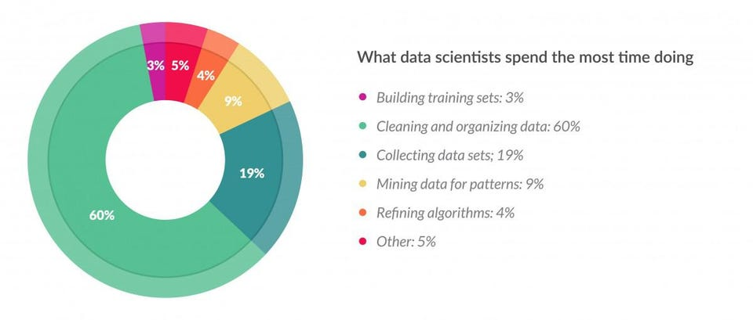

Slide 7
Many companies and individuals can exert effort and still fail in marketing their products . It is due to of several reasons like they don’t understand their customer ,poor targeting , what customers need and they don’t know enough information about their competing products

Slide 8
solution

Slide 9
Build a System analyzer
System analyzer generates :
Preprocessed data.
Sentiment Analysis(Rate of positivity and negativity ).

Slide 10
How ?

Slide 11
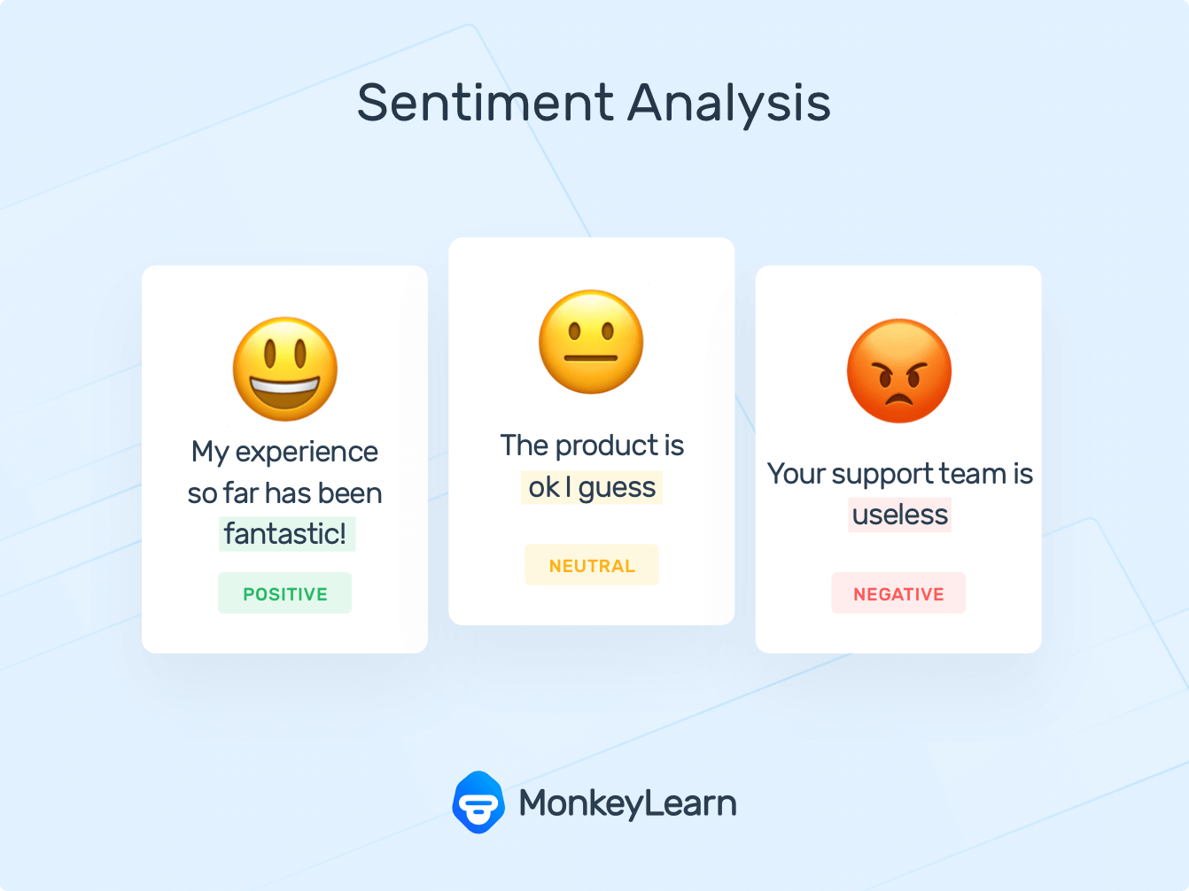
Sentiment analysis (or opinion mining) : is a natural language processing technique used to determine whether data is positive, negative or neutral.
Sentiment analysis

Slide 12

Sentiment analysis :
the result of our model Is refer to the positivity and negativity of comments the result in this project if more than 50% is posititve else is negative

Slide 13
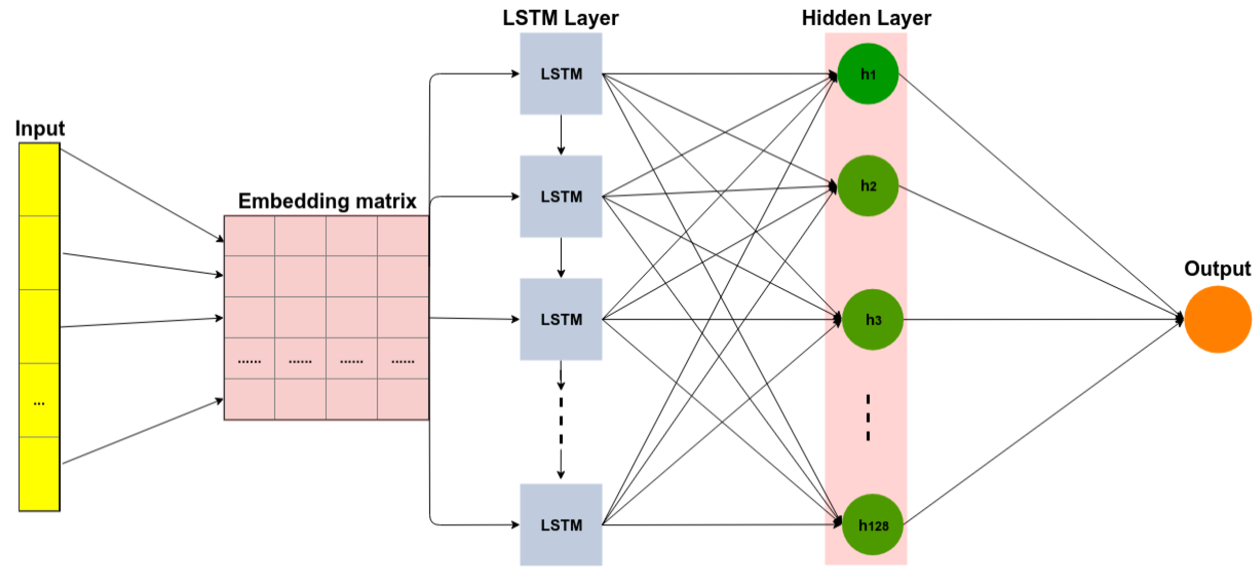
Long short-term memory (LSTM) is an artificial recurrent neural network (RNN) architecture. used in the field of deep learning.
LSTM Model

Slide 14
Steps before apply data in model
Preprocessing
Apply it in word embedding
Turn the word to vector
Training Model
Apply it in the model For sentiment analysis

Slide 15
Word2vec
is a technique for natural language processing published in 2013.
The word2vec algorithm uses a neural network model to learn word associations from a large corpus of text.
Once trained, such a model can detect synonymous words or suggest additional words for a partial sentence.

Slide 16
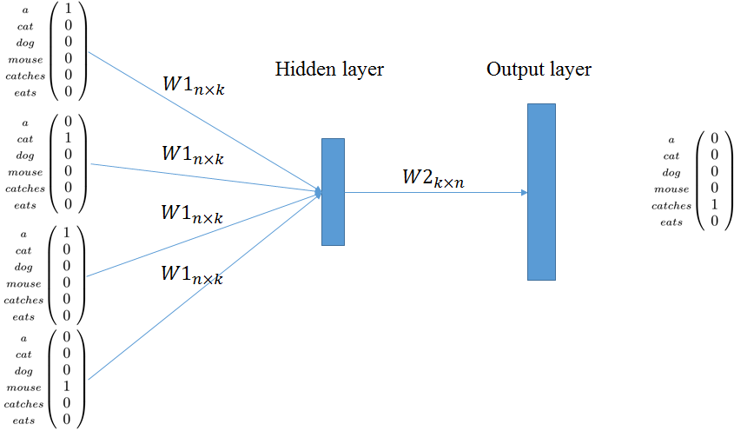
As the name implies, word2vec represents each distinct word with a particular list of numbers called a vector.

Slide 17
LSTM Model
1- The Challenges for LSTM model
2- Recurrent Model
3- The Problem Of Long-Term Dependencies

Slide 18
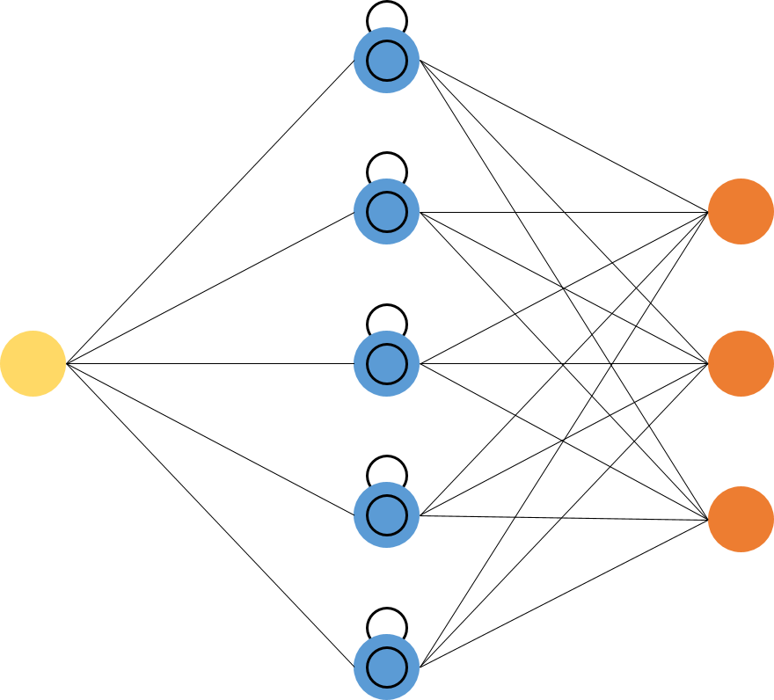
LSTM
LSTM Network
The Core Concept Of LSTMs
Advantages Of LSTM

Slide 19
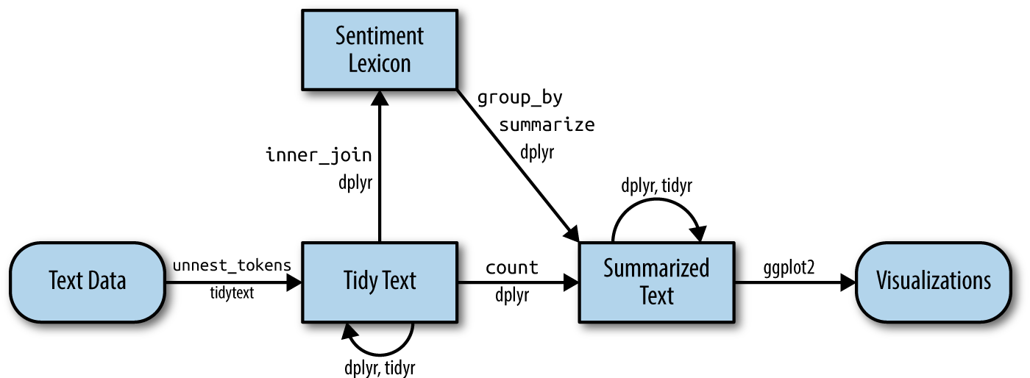

Slide 20
Labelled Data
The sentence is passed to labelled to put sentiment label front each sentence

Slide 21
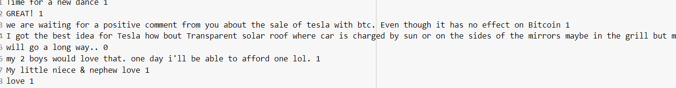

Slide 22
NLP
Natural language processing (NLP) is the ability of a computer program to understand human language as it is spoken and written -- referred to as natural language. It is a component of artificial intelligence (AI).

Slide 23
preprocessing
Preprocessing Techniques :
Preprocessing your text means : converting it into a format that is predictable and analyzable for your task.
A task is a mix of approach and domain in this case.

Slide 24
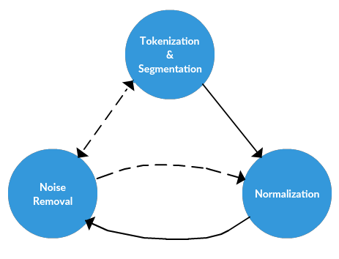
preprocessing
The ideal preprocessing for one task may be the worst nightmare for another. So keep in mind that text preprocessing isn't easily transferable from one task to the next

Slide 25
Preprocessing steps
Tokenization
remove_non_ascii
Lowercase
remove_punctuation
replace_numbers
remove_stopwords
stem_words
lemmatize_verbs

Slide 26
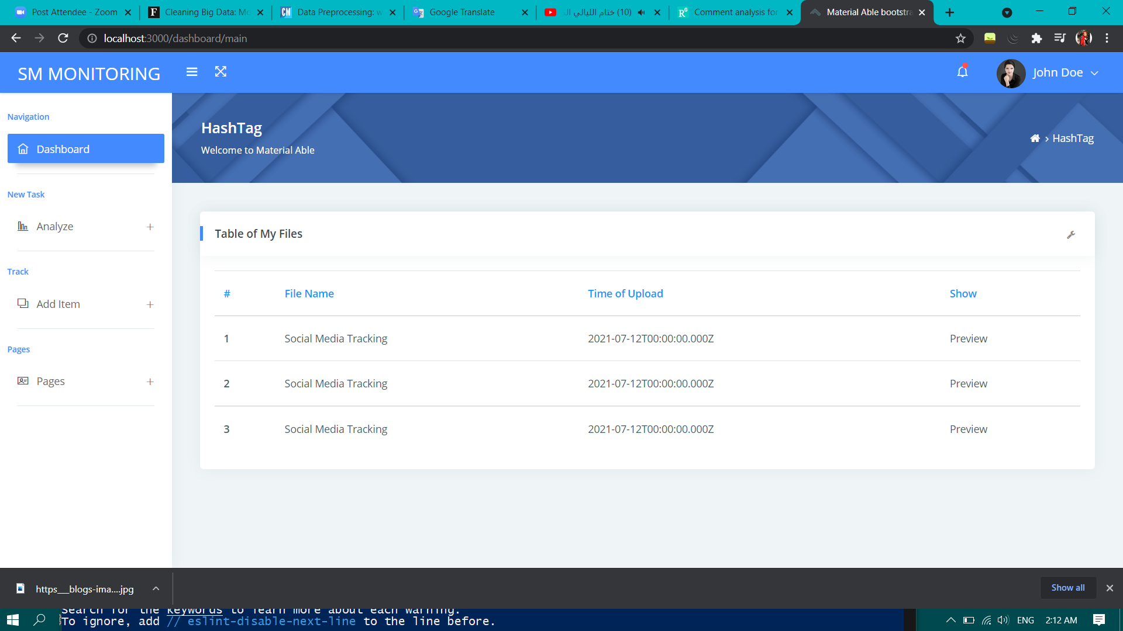
Web application
Build a web application to receive files that would be analyzed .

Slide 27
Rate of positivity and negativity .
According to the rate of positivity and negativity that system analayzer can generate ,we build a web scrapper to scrape data which can help products’ owner to get reviews from websites .

Slide 28
React.js
React is a JavaScript library for building user interfaces . Basically Its depend on component concept .so we should create components that closed on them selves . then put these components together to create user interface .single component could be use multiple time in web page

Slide 29
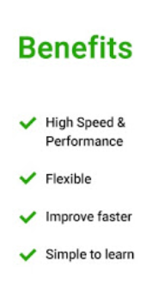
Why we use it ?
update only the parts of your DOM tree that depend on those changes. to re-render your whole UI .
help us to keep cleaner, more organized code. throughout our whole application. We can have as many React components as we want.

Slide 30
Scrapping
Data scraping, also known as web scraping, is the process of importing information from a website into a spreadsheet or local file saved on your computer. .

Slide 31
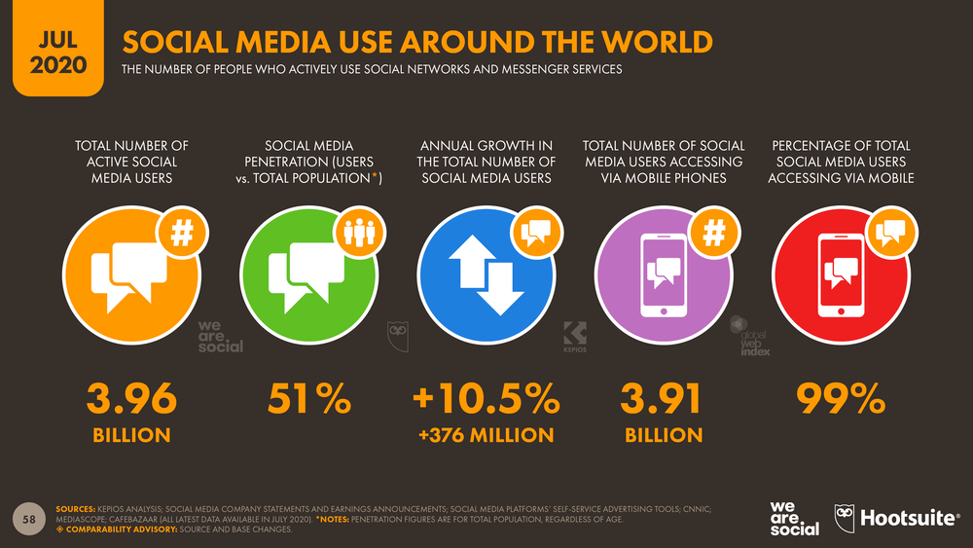

Slide 32
Twitter
Scraping their tweets, mentions, likes, shares, and other engagement will help you study the behavior and gauge on that opinion to understand trends. This data will help you make some big decisions like designing products, customizing it, cater to the real needs through effective marketing..

Slide 33
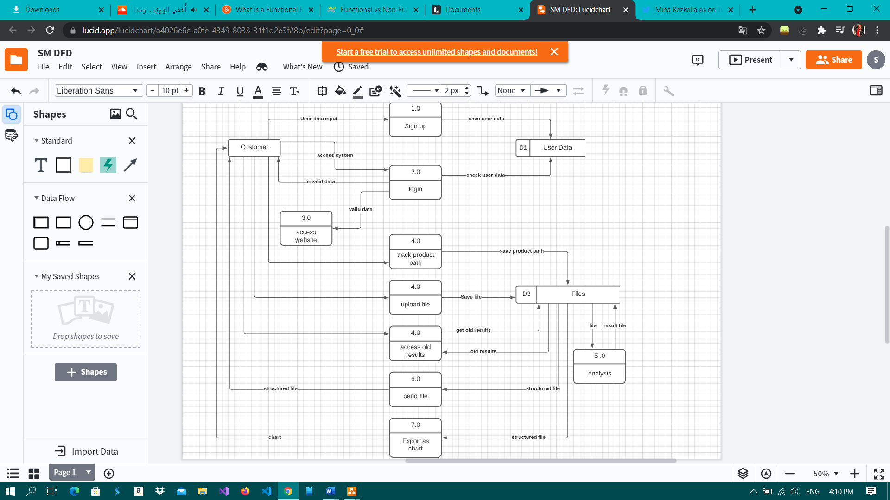

Slide 34
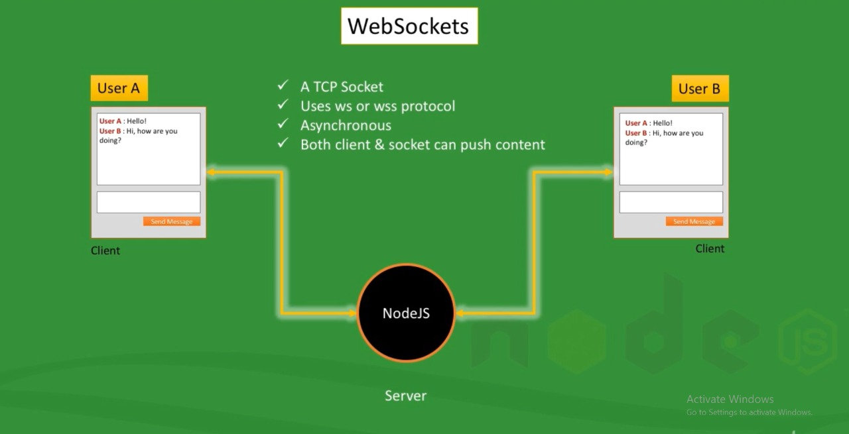
Web socket

Slide 35
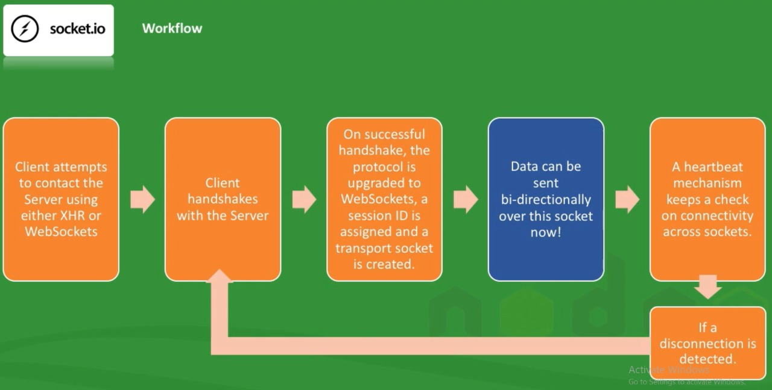
Web socket

Slide 36
Why our project

Slide 37
compare between
Exist systems
Our system
Extract content from web sites and save it as clean structured spreadsheet
only
Extract content from websites and classification the result positively and negatively
Or upload unstructured file and preprocesing it to get structured file

Slide 38
Challenges

Slide 39
Risk and challenges
This model was a small dataset, so it was a little accuracy.
Docker alpine with node js and chromium headless - puppeter - failed to launch chrome

Slide 40
Future work

Slide 41
Future work
The application supports many languages such as Arabic, French, Hindi……. etc.
It will not be limited only to certain sites such as Instagram, Twitter and Amazon.

Slide 42
Future work
Convert to real time application and setup notification
Make an mobile version of this project (android , ios).

Slide 43
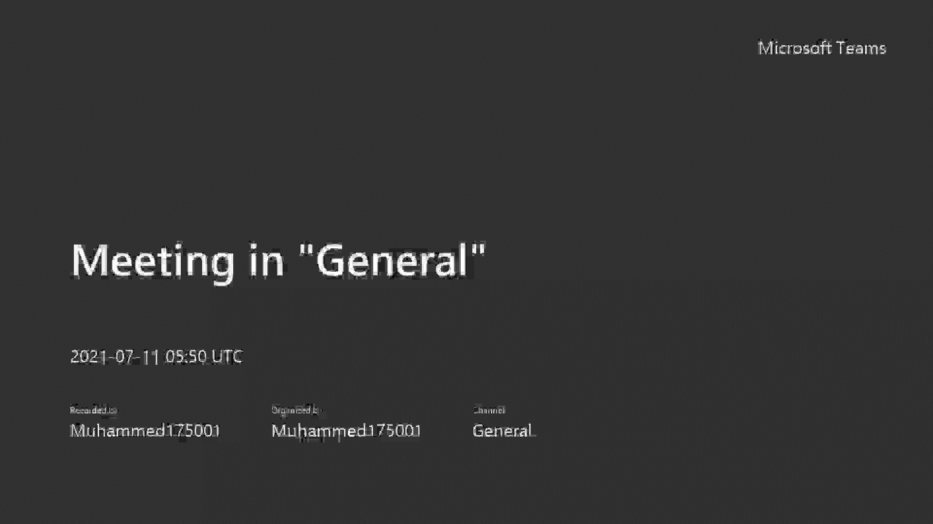

Slide 44
Thank you!

